Slide 1

8th Grade Math: Pre-Algebra
Unit 3, Lesson 6 Multiplying Numbers Expressed in Scientific Notation Volume 1, pg. 107

Slide 2


Benchmark
MA.8.NSO.1.5
Add, subtract, multiply, and divide numbers expressed in scientific notation with procedural fluency.
volume 1, pg. 107

Slide 3
Integrated Mathematical Thinking and Reasoning Standards
MA.K12.MTR.1.1 Actively participate in effortful learning both individually and collectively.
MA.K12.MTR.3.1 Complete tasks with mathematical fluency.
MA.K12.MTR.4.1 Engage in discussions that reflect on the mathematical thinking of self and others.
volume 1, pg. 107

Slide 4

Learning Target
I can multiply numbers expressed in scientific notation.
volume 1, pg. 107

Slide 5

Warm-Up
volume 1, pg. 108

Slide 6
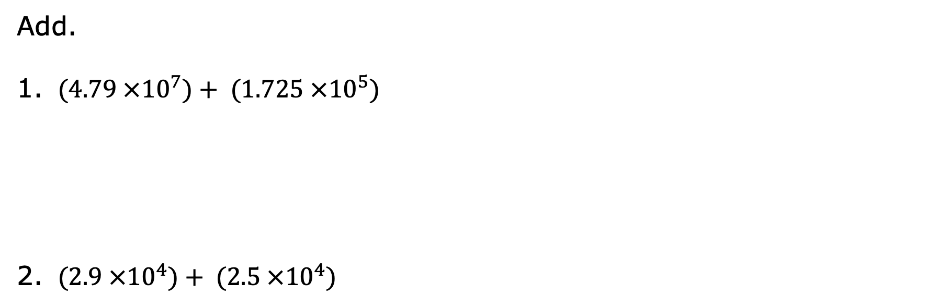
3.6.1 Warm-Up: Bell Work
Add.
$(4.79 ×{10}^{7})+ (1.725 ×{10}^{5})$
$(2.9 ×{10}^{4})+ (2.5 ×{10}^{4})$
volume 1, pg. 108
Notes:
Video Link: https://algebranation.wistia.com/medias/fi4fidi5y8

Slide 7
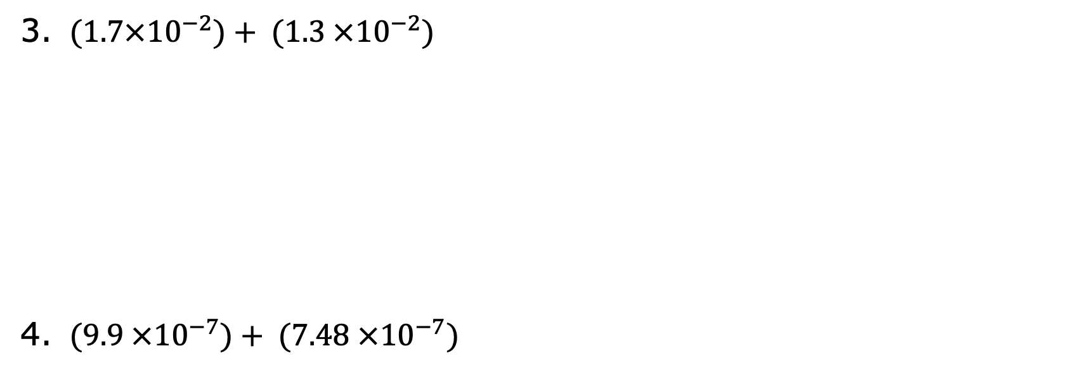
$(1.7×{10}^{−2})+ (1.3 ×{10}^{−2})$
$(9.9 ×{10}^{−7})+ (7.48 ×{10}^{−7})$
volume 1, pg. 108
Notes:
Video Link: https://algebranation.wistia.com/medias/fi4fidi5y8

Slide 8

Guided Instruction
volume 1, pg. 108

Slide 9


3.6.2 Guided Instruction: Multiplying Numbers Expressed in Scientific Notation
Find the product of each.
$(7.8×{10}^{14})(2.5×{10}^{16})$
$(1.2×{10}^{−9})(3.2×{10}^{−7})$
volume 1, pg. 108

Slide 10
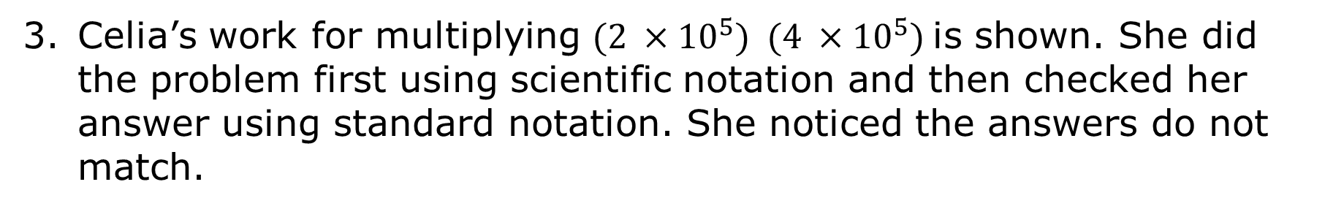
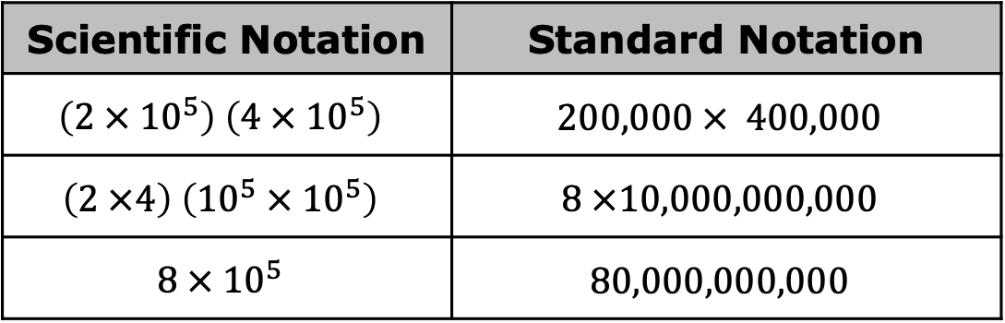
Celia’s work for multiplying $(2 ×{10}^{5}) (4 ×{10}^{5})$is shown. She did the problem first using scientific notation and then checked her answer using standard notation. She noticed the answers do not match.
Scientific Notation | Standard Notation
$$\left(2 × {10}^{5}\right) \left(4 × {10}^{5}\right)$$ | $$200,000 × 400,000$$
$$\left(2 ×4\right) \left({10}^{5} × {10}^{5}\right)$$ | $$8 ×10,000,000,000$$
$$8 × {10}^{5}$$ | $$80,000,000,000$$
volume 1, pg. 108

Slide 11
Find Celia’s mistake, then write her a note to help her learn from her mistake.
Means
I
Start
To
Acquire
Knowledge
Experience
Skills
volume 1, pg. 108

Slide 12

Guided Practice
volume 1, pg. 109

Slide 13

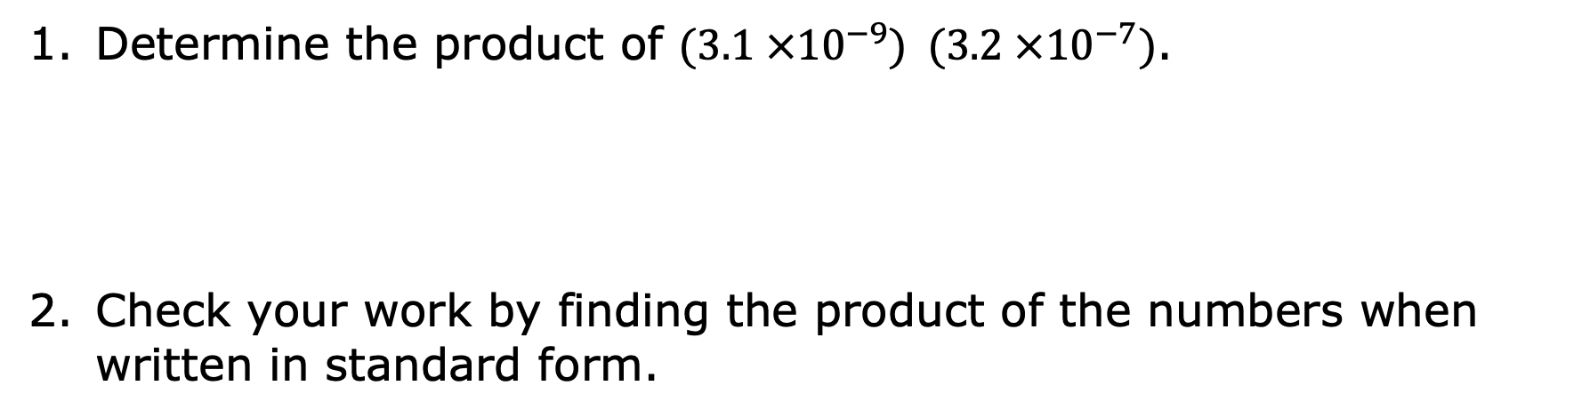
3.6.3 Guided Practice: Multiplying Numbers Expressed in Scientific Notation
Determine the product of $(3.1 ×{10}^{−9}) (3.2 ×{10}^{−7})$.
Check your work by finding the product of the numbers when written in standard form.
volume 1, pg. 109

Slide 14
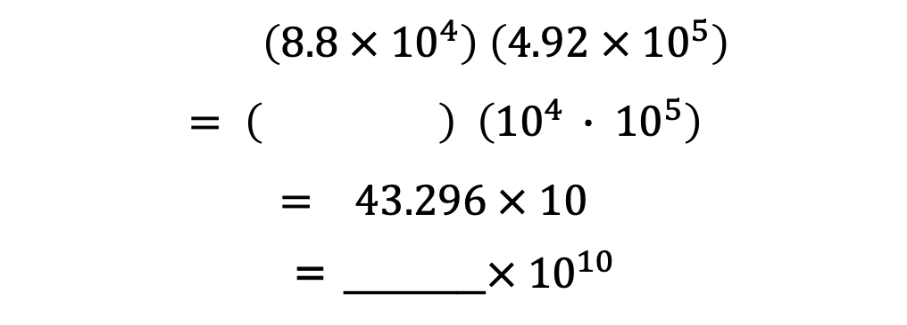
Complete the work to find the product. Be sure to write your answer in scientific notation.
$$\left(8.8 × {10}^{4}\right) \left(4.92 × {10}^{5}\right)$$
$$= \left( \right) \left({10}^{4 }∙ {10}^{5}\right)$$
$$= 43.296 × {10}^{ }$$
= _____$× {10}^{10}$
volume 1, pg. 109

Slide 15

Activity
volume 1, pg. 109

Slide 16

3.6.4 Activity: Give Me Five!
You and your partner will be given a set of problem cards and a gameboard. Your goal is to get five squares in a row, horizontally, vertically, or diagonally, marked on the gameboard. To mark a square, you need to correctly find the product of a given problem.
Record each problem you complete on the recording sheet. Not all of the spaces must be filled in order for a winner to be determined.
volume 1, pg. 109

Slide 17
Give Me Five! - Recording Sheet
Problem #: ___ Answer:________ Work: | Problem #: ___ Answer:________ Work: | Problem #: ___ Answer: _______ Work:
Problem #: ___ Answer:________ Work: | Problem #: ___ Answer: _______ Work: | Problem #: ___ Answer:________ Work:
volume 1, pg. 109

Slide 18
Problem #: ___ Answer:________ Work: | Problem #: ___ Answer:________ Work: | Problem #: ___ Answer: _______ Work:
Problem #: ___ Answer:________ Work: | Problem #: ___ Answer: _______ Work: | Problem #: ___ Answer:________ Work:
volume 1, pg. 110

Slide 19
Problem #: ___ Answer:________ Work: | Problem #: ___ Answer:________ Work: | Problem #: ___ Answer: _______ Work:
Problem #: ___ Answer:________ Work: | Problem #: ___ Answer: _______ Work: | Problem #: ___ Answer:________ Work:
volume 1, pg. 110

Slide 20

Wrap-Up
volume 1, pg. 110

Slide 21
3.6.5 Wrap-Up: Growth Mindset
Which mindset did I demonstrate? | Choose the best description.
Did I use the partner discussions as learning opportunities? | Never Sometimes | Usually Always
Did I work on problems that challenged me? | Never Sometimes | Usually Always
Did I use strategies to 'un-stick' myself when I found the problems difficult? | Never Sometimes | Usually Always
Did I put as much effort as I possibly could into the problems? | Never Sometimes | Usually Always
volume 1, pg. 110

